Slide 1


CSB4202 - DATABASE MANAGEMENT SYSTEMS
B.Tech – III Semester
Dr. A. Antonidoss/Dr.Sathya Priya.S
Associate professor
School of Computing Sciences,
Department of Computer Science and Engineering

Slide 2
MODULE 3: DATA STORAGE AND QUERY PROCESSING
Record storage and Primary file organization- Secondary storage Devices- Operations on Files- Heap File- Sorted Files- Hashing Techniques – Index Structure for files –Different types of Indexes- B-Tree - B+Tree – Query Processing.

Slide 3
INDEX STRUCTURE FOR FILES- Index
Indexes are additional auxiliary access structures with typically provide either faster access to data or secondary access paths without effecting the physical storage of the data.
They are based on indexing field(s) that are used to construct the index

Slide 4
Types of Indexex
Single-Level Indexes
Primary
Secondary
Clustering
Multi-Level Indexes
ISAM
B Trees
B+ Trees

Slide 5
Single Level Indexes
A Primary Index is specified on the ordering key field where each tuple has a unique value.
A Clustering Index is specified on the ordering key field where each tuple DOES NOT have a unique value in that field.
A Secondary Index is specified on a NON-ORDERING Field of the file.

Slide 6
Types of Indexex
Single-Level Indexes
Primary
Secondary
Clustering
Multi-Level Indexes
ISAM
B Trees
B+ Trees

Slide 7
Types of Indexes
Ordering Field Non-ordering field
Key field Primary index Secondary index (key)
Non key field Clustering index Secondary index (non key)

Slide 8
Single-level Indexex
A Primary Index - specified on the ordering key field where each tuple has a unique value.
A Clustering Index - specified on the ordering key field where each tuple DOES NOT have a unique value in that field.
A Secondary Index is specified on a NON-ORDERING Field of the file.

Slide 9
Primary Index
A primary index is an ordered file whose records are of fixed length with two fields.
The first field is of the same data type as the ordering key field—called the primary key—of the data file,
The second field is a pointer to a disk block (a block address).
There is one index entry (or index record) in the index file for each block in the data file. Each index entry has the value of the primary key field for the first record in a block and a pointer to that block as its two field values.
<K(i), P(i)> - <K(1) = (Adams,John), P(1) = address of block 1>

Slide 10
Clustering Index
If records of a file are physically ordered on a non-key field—which does not have a distinct value for each record—that field is called the clustering field.
Can create a different type of index, called a clustering index- to speed up retrieval of records that have the same value for the clustering field.
A clustering index is also an ordered file with two fields; the first field is of the same type as the clustering field of the data file, and the second field is a block pointer.

Slide 11
Secondary Index
A secondary index is also an ordered file with two fields.
The first field is of the same data type as some non-ordering field of the data file that is an indexing field. The second field is either a block pointer or a record pointer.
A secondary index usually needs more storage space and longer search time than does a primary index, because of its larger number of entries. This can have both key field and non-key field.

Slide 12
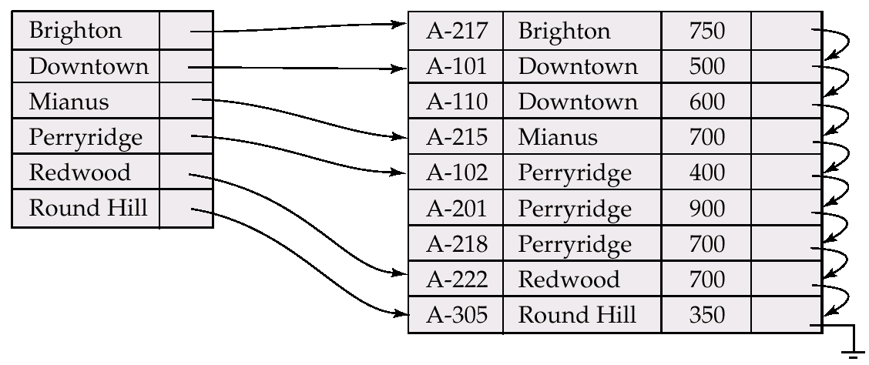
Dense Index Files
Dense index — Index record appears for every search-key value in the file.

Slide 13
Sparse Index Files
Sparse Index: contains index records for only some search-key values.
Applicable when records are sequentially ordered on search-key
To locate a record with search-key value K we:
Find index record with largest search-key value < K
Search file sequentially starting at the record to which the index record points
Less space and less maintenance overhead for insertions and deletions.
Generally slower than dense index for locating records.
Good tradeoff: sparse index with an index entry for every block in file, corresponding to least search-key value in the block.

Slide 14
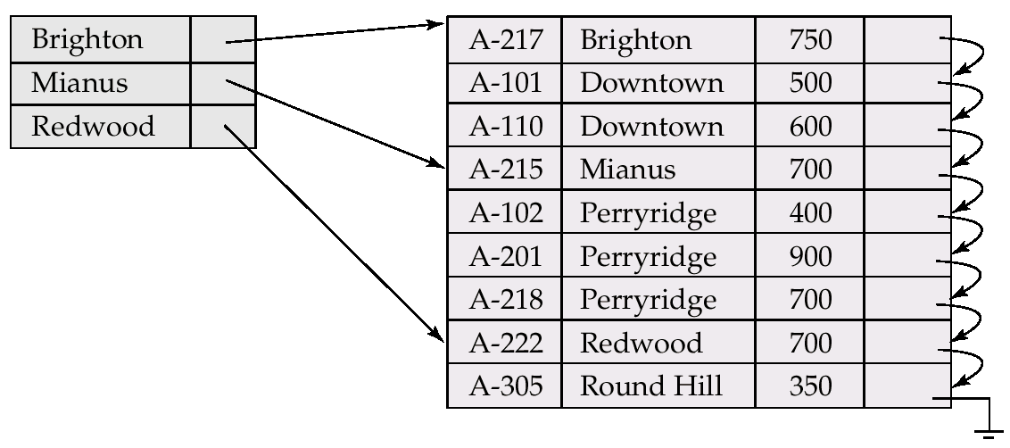
Example of Sparse Index Files

Slide 15
Multilevel Indexes
A Multilevel Index is where you construct an Second- Level index on a First-Level Index.
Continue this process until the entire index can be contained in a Single File Block.
This allows much faster access than binary search because at each level the size of the index is reduced by the fan out factor. (Rather just by 2 as in binary search).

Slide 16
Multilevel Index
If primary index does not fit in memory, access becomes expensive.
To reduce number of disk accesses to index records, treat primary index kept on disk as a sequential file and construct a sparse index on it.
outer index – a sparse index of primary index
inner index – the primary index file
If even outer index is too large to fit in main memory, yet another level of index can be created, and so on.
Indices at all levels must be updated on insertion or deletion from the file.

Slide 17
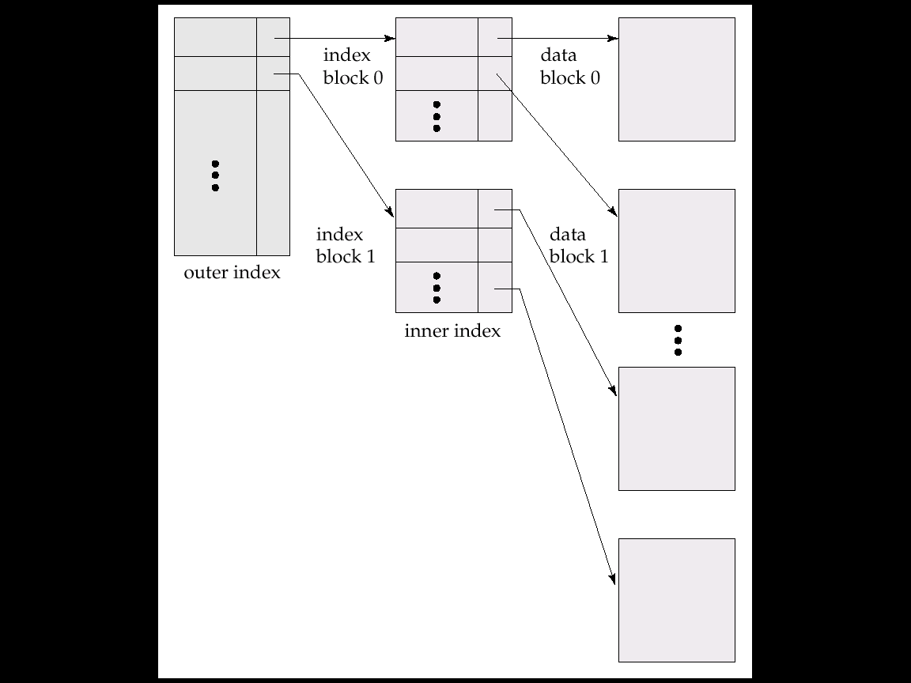
Multilevel Index (Cont.)

Slide 18
Multilevel Indexes Using Search Trees, B-Trees & B+ Trees
A Search Tree of order p differs from a Multilevel Index in that each node contains a most p - 1 search values and p pointers.
There is no requirement that the Search Tree be Balanced.

Slide 19
Index Update: Deletion
If deleted record was the only record in the file with its particular search-key value, the search-key is deleted from the index also.
Single-level index deletion:
Dense indices – deletion of search-key is similar to file record deletion.
Sparse indices – if an entry for the search key exists in the index, it is deleted by replacing the entry in the index with the next search-key value in the file (in search-key order). If the next search-key value already has an index entry, the entry is deleted instead of being replaced.

Slide 20
Index Update: Insertion
Single-level index insertion:
Perform a lookup using the search-key value appearing in the record to be inserted.
Dense indices – if the search-key value does not appear in the index, insert it.
Sparse indices – if index stores an entry for each block of the file, no change needs to be made to the index unless a new block is created. In this case, the first search-key value appearing in the new block is inserted into the index.
Multilevel insertion (as well as deletion) algorithms are simple extensions of the single-level algorithms

Slide 21
B⁺-Tree Index Files
B⁺-tree indices are an alternative to indexed-sequential files.
Disadvantage of indexed-sequential files: performance degrades as file grows, since many overflow blocks get created. Periodic reorganization of entire file is required.
Advantage of B⁺-tree index files: automatically reorganizes itself with small, local, changes, in the face of insertions and deletions. Reorganization of entire file is not required to maintain performance.
Disadvantage of B⁺-trees: extra insertion and deletion overhead, space overhead.
Advantages of B⁺-trees outweigh disadvantages, and they are used extensively.

Slide 22
B⁺-Tree Index Files (Cont.)
A B⁺-tree is a rooted tree satisfying the following properties:
All paths from root to leaf are of the same length
Each node that is not a root or a leaf has between [n/2] and n children.
A leaf node has between [(n–1)/2] and n–1 values
Special cases:
If the root is not a leaf, it has at least 2 children.
If the root is a leaf (that is, there are no other nodes in the tree), it can have between 0 and (n–1) values.

Slide 23
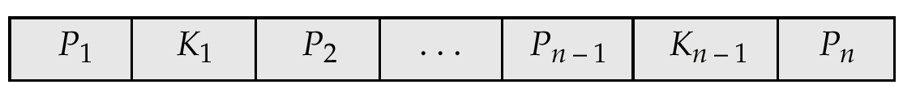
B⁺-Tree Node Structure
Typical node
K_{i} are the search-key values
P_{i} are pointers to children (for non-leaf nodes) or pointers to records or buckets of records (for leaf nodes).
The search-keys in a node are ordered
K₁ < K₂ < K₃ < . . . < K_{n–1}

Slide 24
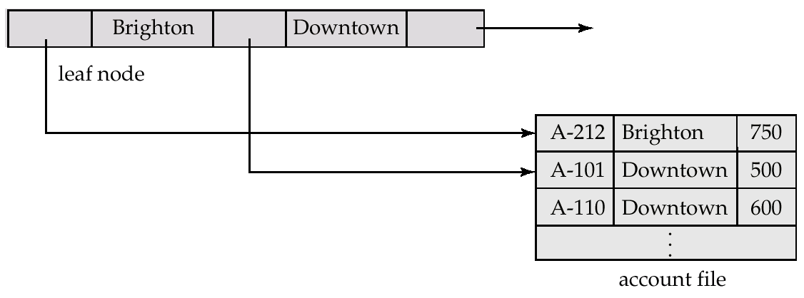
Leaf Nodes in B⁺-Trees
Properties of a leaf node:
For i = 1, 2, . . ., n–1, pointer P_{i} either points to a file record with search-key value K_{i}, or to a bucket of pointers to file records, each record having search-key value K_{i}. Only need bucket structure if search-key does not form a primary key.
If L_{i}, L_{j} are leaf nodes and i < j, L_{i}’s search-key values are less than L_{j}’s search-key values
P_{n} points to next leaf node in search-key order

Slide 25
Non-Leaf Nodes in B⁺-Trees
Non leaf nodes form a multi-level sparse index on the leaf nodes. For a non-leaf node with m pointers:
All the search-keys in the subtree to which P₁ points are less than K₁
For 2 ≤ i ≤ n – 1, all the search-keys in the subtree to which P_{i} points have values greater than or equal to K_{i–1} and less than K_{m–1}

Slide 26
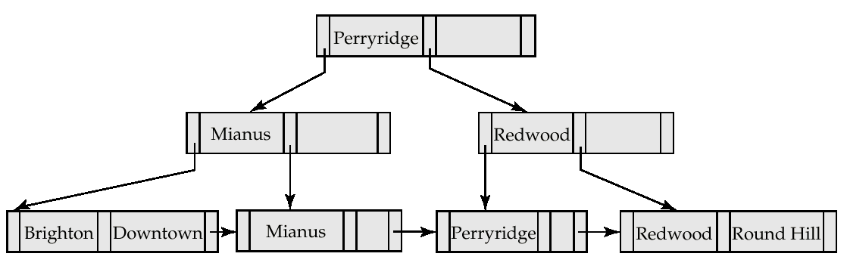
Example of a B⁺-tree
B⁺-tree for account file (n = 3)

Slide 27
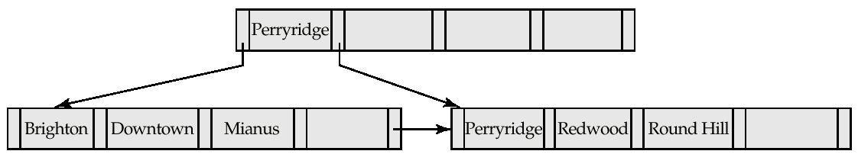
Example of B⁺-tree
B⁺-tree for account file (n = 5)
Leaf nodes must have between 2 and 4 values (⎡(n–1)/2⎤ and n –1, with n = 5).
Non-leaf nodes other than root must have between 3 and 5 children (⎡(n/2⎤ and n with n =5).
Root must have at least 2 children.

Slide 28
Observations about B⁺-trees
Since the inter-node connections are done by pointers, “logically” close blocks need not be “physically” close.
The non-leaf levels of the B⁺-tree form a hierarchy of sparse indices.
The B⁺-tree contains a relatively small number of levels (logarithmic in the size of the main file), thus searches can be conducted efficiently.
Insertions and deletions to the main file can be handled efficiently, as the index can be restructured in logarithmic time (as we shall see).

Slide 29
Queries on B⁺-Trees
Find all records with a search-key value of k.
Start with the root node
Examine the node for the smallest search-key value > k.
If such a value exists, assume it is K_{j}. Then follow P_{i} to the child node
Otherwise k ≥ K_{m–1}, where there are m pointers in the node. Then follow P_{m} to the child node.
If the node reached by following the pointer above is not a leaf node, repeat the above procedure on the node, and follow the corresponding pointer.
Eventually reach a leaf node. If for some i, key K_{i} = k follow pointer P_{i} to the desired record or bucket. Else no record with search-key value k exists.

Slide 30
Updates on B⁺-Trees: Insertion
Find the leaf node in which the search-key value would appear
If the search-key value is already there in the leaf node, record is added to file and if necessary a pointer is inserted into the bucket.
If the search-key value is not there, then add the record to the main file and create a bucket if necessary. Then:
If there is room in the leaf node, insert (key-value, pointer) pair in the leaf node
Otherwise, split the node (along with the new (key-value, pointer) entry) as discussed in the next slide.

Slide 31
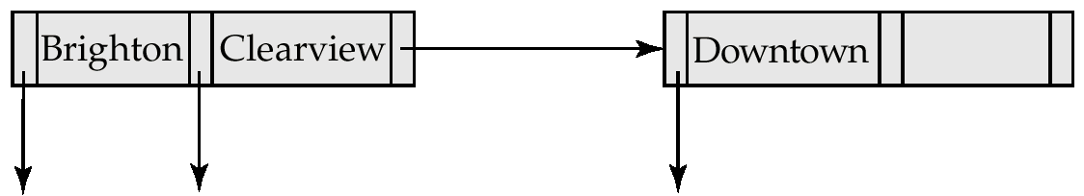
Updates on B⁺-Trees: Insertion (Cont.)
Splitting a node:
take the n(search-key value, pointer) pairs (including the one being inserted) in sorted order. Place the first ⎡ n/2 ⎤ in the original node, and the rest in a new node.
let the new node be p, and let k be the least key value in p. Insert (k,p) in the parent of the node being split. If the parent is full, split it and propagate the split further up.
The splitting of nodes proceeds upwards till a node that is not full is found. In the worst case the root node may be split increasing the height of the tree by 1.
Result of splitting node containing Brighton and Downtown on inserting Clearview

Slide 32
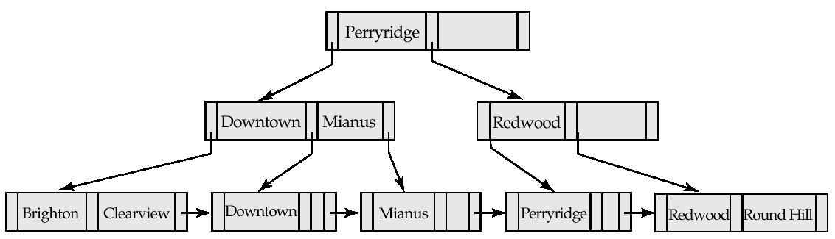
Updates on B⁺-Trees: Insertion (Cont.)
B⁺-Tree before and after insertion of “Clearview”

Slide 33
Updates on B⁺-Trees: Deletion
Find the record to be deleted, and remove it from the main file and from the bucket (if present)
Remove (search-key value, pointer) from the leaf node if there is no bucket or if the bucket has become empty
If the node has too few entries due to the removal, and the entries in the node and a sibling fit into a single node, then
Insert all the search-key values in the two nodes into a single node (the one on the left), and delete the other node.
Delete the pair (K_{i–1}, P_{i}), where P_{i} is the pointer to the deleted node, from its parent, recursively using the above procedure.

Slide 34
Updates on B⁺-Trees: Deletion
Otherwise, if the node has too few entries due to the removal, and the entries in the node and a sibling fit into a single node, then
Redistribute the pointers between the node and a sibling such that both have more than the minimum number of entries.
Update the corresponding search-key value in the parent of the node.
The node deletions may cascade upwards till a node which has ⎡n/2 ⎤ or more pointers is found. If the root node has only one pointer after deletion, it is deleted and the sole child becomes the root.

Slide 35
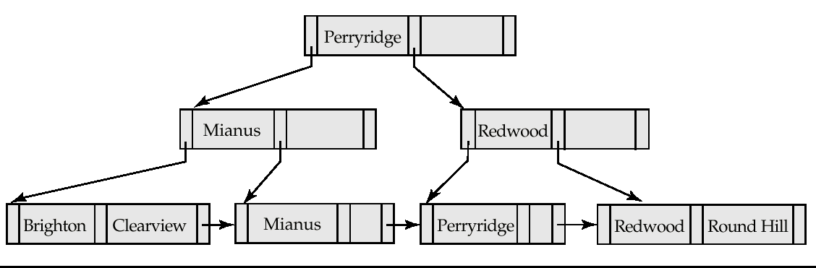
Examples of B⁺-Tree Deletion
Before and after deleting “Downtown”
The removal of the leaf node containing “Downtown” did not result in its parent having too little pointers. So the cascaded deletions stopped with the deleted leaf node’s parent.

Slide 36
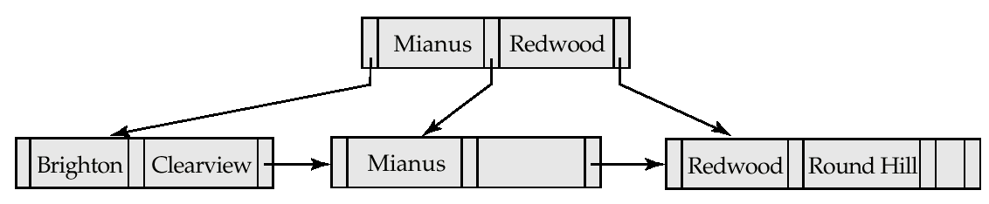
Examples of B⁺-Tree Deletion (Cont.)
Deletion of “Perryridge” from result of previous example
Node with “Perryridge” becomes underfull (actually empty, in this special case) and merged with its sibling.
As a result “Perryridge” node’s parent became underfull, and was merged with its sibling (and an entry was deleted from their parent)
Root node then had only one child, and was deleted and its child became the new root node

Slide 37
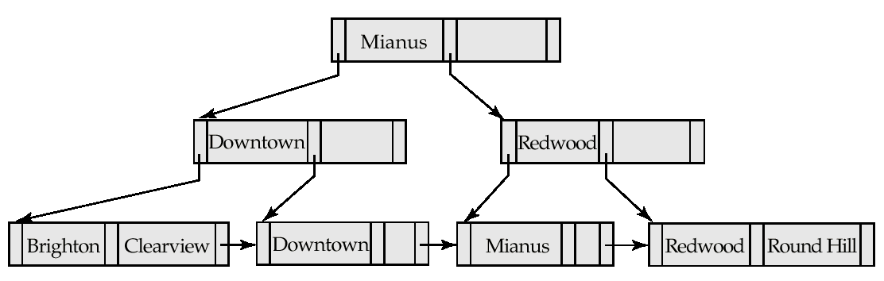
Example of B⁺-tree Deletion (Cont.)
Before and after deletion of “Perryridge” from earlier example
Parent of leaf containing Perryridge became underfull, and borrowed a pointer from its left sibling
Search-key value in the parent’s parent changes as a result

Slide 38
B⁺-Tree File Organization
Index file degradation problem is solved by using B⁺-Tree indices. Data file degradation problem is solved by using B⁺-Tree File Organization.
The leaf nodes in a B⁺-tree file organization store records, instead of pointers.
Since records are larger than pointers, the maximum number of records that can be stored in a leaf node is less than the number of pointers in a nonleaf node.
Leaf nodes are still required to be half full.
Insertion and deletion are handled in the same way as insertion and deletion of entries in a B⁺-tree index.

Slide 39
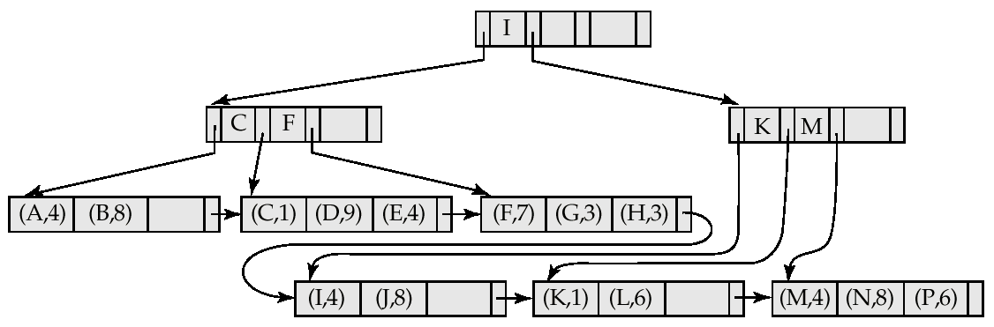
B⁺-Tree File Organization (Cont.)
Example of B⁺-tree File Organization
Good space utilization important since records use more space than pointers.
To improve space utilization, involve more sibling nodes in redistribution during splits and merges
Involving 2 siblings in redistribution (to avoid split / merge where possible) results in each node having at least entries

Slide 40
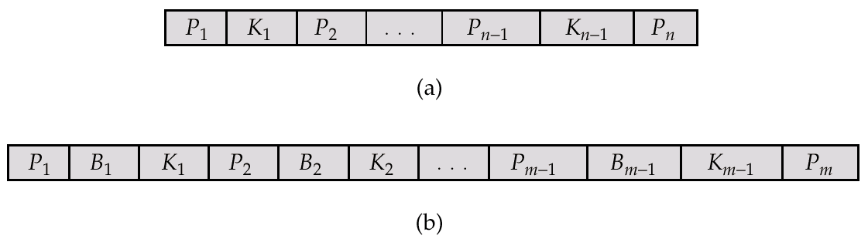
B-Tree Index Files
Similar to B+-tree, but B-tree allows search-key values to appear only once; eliminates redundant storage of search keys.
Every node must be filled atleast half.Ex:degree-10, then atleast 5 keys in each node.Root can have min. 2 children.(atleast 1 key).
All leaf nodes at same level.Bottom up creation process.
Search keys in nonleaf nodes appear nowhere else in the B-tree; an additional pointer field for each search key in a nonleaf node must be included.
Generalized B-tree leaf node
Nonleaf node – pointers B_{i} are the bucket or file record pointers.

Slide 41
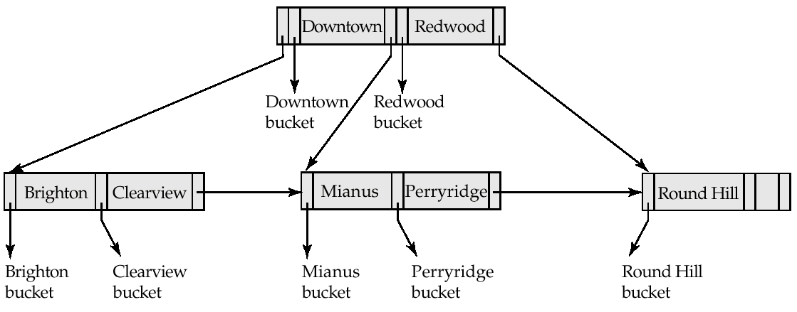
B-Tree Index File Example
B-tree (above) and B+-tree (below) on same data

Slide 42
B-Tree Index Files (Cont.)
Advantages of B-Tree indices:
May use less tree nodes than a corresponding B⁺-Tree.
Sometimes possible to find search-key value before reaching leaf node.
Disadvantages of B-Tree indices:
Only small fraction of all search-key values are found early
Non-leaf nodes are larger, so fan-out is reduced. Thus, B-Trees typically have greater depth than corresponding B⁺-Tree
Insertion and deletion more complicated than in B⁺-Trees
Implementation is harder than B⁺-Trees.
Typically, advantages of B-Trees do not out weigh disadvantages.

Slide 43
Comparison between B Tree and B+ Tree
Categories | B Tree | B+ Tree
Descriptions | A B tree is an organizational structure for information storage and retrieval in the form of a tree in which all terminal nodes are at the same distance from the base, and all non-terminal nodes have between n and 2 n sub-trees or pointers (where n is an integer). | B+ tree is an n-array tree with a variable but often large number of children per node. A B+ tree consists of a root, internal nodes and leaves. The root may be either a leaf or a node with two or more children.
Also known as | Balanced tree. | B plus tree.
Space | O(n) | O(n)
Search | O(log n) | O(log_{b} n)
Insert | O(log n) | O(log_{b} n)
Delete | O(log n) | O(log_{b} n)
Storage | In a B tree, search keys and data stored in internal or leaf nodes. | In a B+ tree, data stored only in leaf nodes.
Data | The leaf nodes of the tree store pointers to records rather than actual records. | The leaf nodes of the tree stores the actual record rather than pointers to records.
Function of leaf nodes | In B tree, the leaf node cannot store using linked list. | In B+ tree, leaf node data are ordered in a sequential linked list.
Searching | Here, searching becomes difficult in B- tree as data cannot be found in the leaf node. | Here, searching of any data in a B+ tree is very easy because all data is found in leaf nodes.
Search accessibility | Here in B tree the search is not that easy as compared to a B+ tree. | Here in B+ tree the searching becomes easy.
Redundant key | They do not store redundant search key. | They store redundant search key.
Applications | They are an older version and are not that advantageous as compared to the B+ trees. | Many database system implementers prefer the structural simplicity of a B+ tree.

Slide 44
Link for B Trees and B+ Trees:
https://www.youtube.com/watch?v=aZjYr87r1b8

